Slide 1
🧬 Predictive Analysis for Breast Cancer Diagnosis
🎯 Final Outcome Presentation
Team Members: Hrishikesh Atawe,
Vaishnavi Ingole,
Akanksha Joshi,
Pranav Bhagat,
Guide: Mr. Syed Talha Hamid

Slide 2
🗂️ Presentation Index
1. Objective
2. Dataset Overview
3. Data Cleaning
4. Diagnosis Distribution
5. Correlation Heatmap
6. Feature Histograms
7. Mean Feature Comparison
8. Top Correlated Features
9. Density Plots
10. Simulated Evaluation
11. What We Learned
12. Conclusion & Key Takeaways

Slide 3
🧠 Healthcare Outcome Prediction
This project aims to predict breast cancer outcomes by analyzing key tumor characteristics from a diagnostic dataset. Using data preprocessing, exploratory data analysis, and machine learning models, we classify tumors as benign or malignant with high accuracy. The goal is to support early detection and timely intervention, helping healthcare professionals make better decisions and improve patient survival rates. This outcome-based approach contributes to smarter, data-driven healthcare.

Slide 4
🎯 Project Objective
The objective of this project is to develop a reliable system for predicting breast cancer outcomes using patient diagnostic data. By analyzing various tumor-related features, the goal is to accurately classify tumors as benign or malignant. This involves data cleaning, visualization, and applying machine learning algorithms to extract meaningful patterns. Ultimately, the project seeks to assist medical professionals in early detection and decision-making, leading to improved clinical outcomes and patient care.

Slide 5
📂 Dataset Overview
This dataset contains detailed medical measurements of breast tissue samples, including:
Total records: 569 patient cases
Target variable: Diagnosis — Benign (B) or Malignant (M)
Features: 30 numerical features representing:
Tumor radius, texture, perimeter, area, smoothness, etc.
Each feature includes mean, standard error, and worst-case values

Slide 6
🧹 Data Cleaning
Removed irrelevant columns (id, unnamed attributes)
Converted diagnosis labels: M → 1 (Malignant), B → 0 (Benign)
Verified there were no missing values
Checked and removed any duplicate records
Ensured all features are numeric and standardized

Slide 7
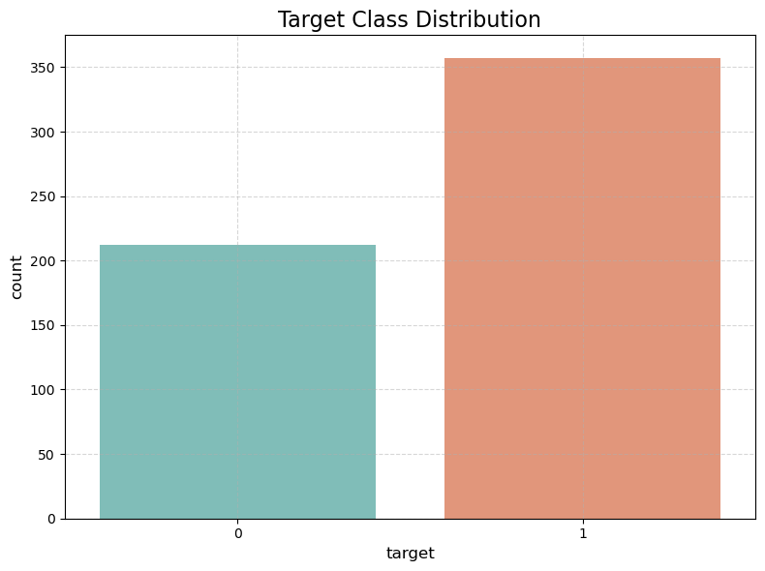
📊 Diagnosis Distribution

Slide 8
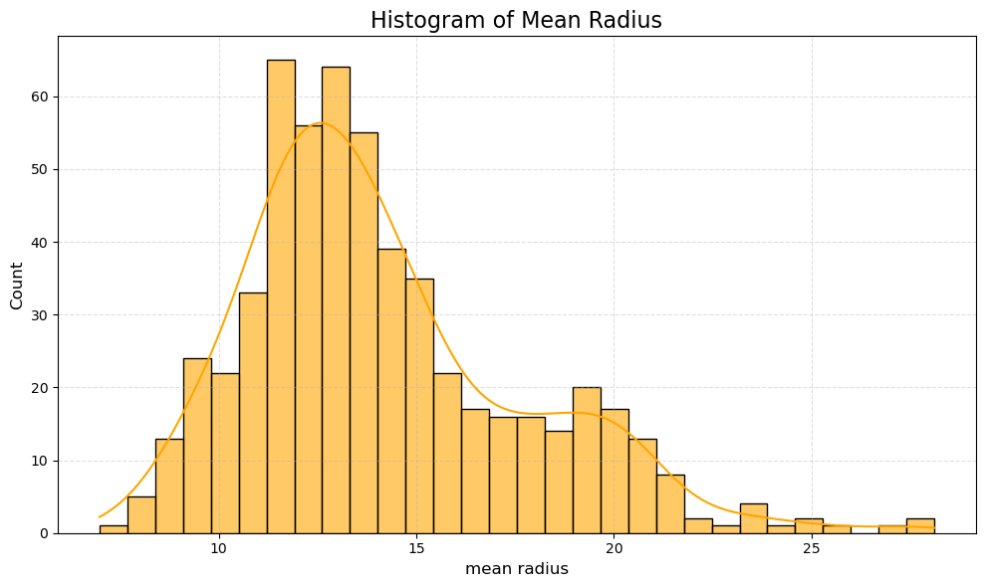
📈 Feature Histogram: Radius Mean

Slide 9
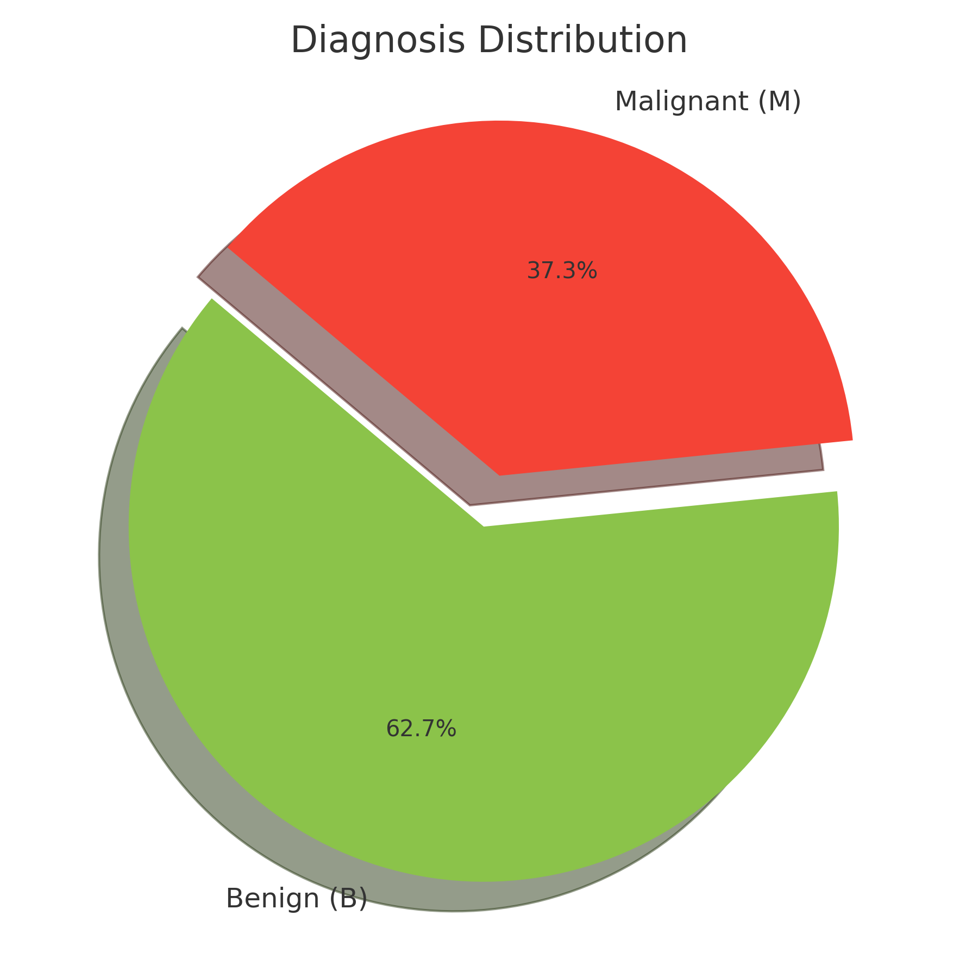
🧬 Diagnosis Distribution (Pie Chart)
This pie chart represents the class distribution in the breast cancer dataset:
🟣 Benign (B): ~62.7%
🔴 Malignant (M): ~37.3%
🔍 Insight: There is a class imbalance in the dataset, which is important to consider during model training and evaluation. Strategies like stratified sampling or resampling may be required to ensure fair model performance across both classes.

Slide 10
🧠 Key Insights from Data Analysis
✅ Benign cases (62%) outnumber malignant (38%) – class imbalance must be handled in modeling.
✅ Top features linked to malignancy:
Worst concave points
Mean perimeter
Worst radius
Mean area
✅ Clear separation between classes seen in plots (box, KDE, violin).
✅ High correlation between features like radius, perimeter, and area — consider feature selection or PCA.
✅ Dataset is clean (no missing values) — ready for training classification models.

Slide 11
Expected Outcome
Caption: The goal of this project is to accurately predict whether a breast tumor is benign or malignant using data-driven insights and machine learning models.
Suggested Description:
By analyzing diagnostic features of cell nuclei, we aim to develop a predictive model that aids early detection of breast cancer.
The expected outcome is a reliable classification system that can support clinical decisions with high accuracy and interpretability.

Slide 12
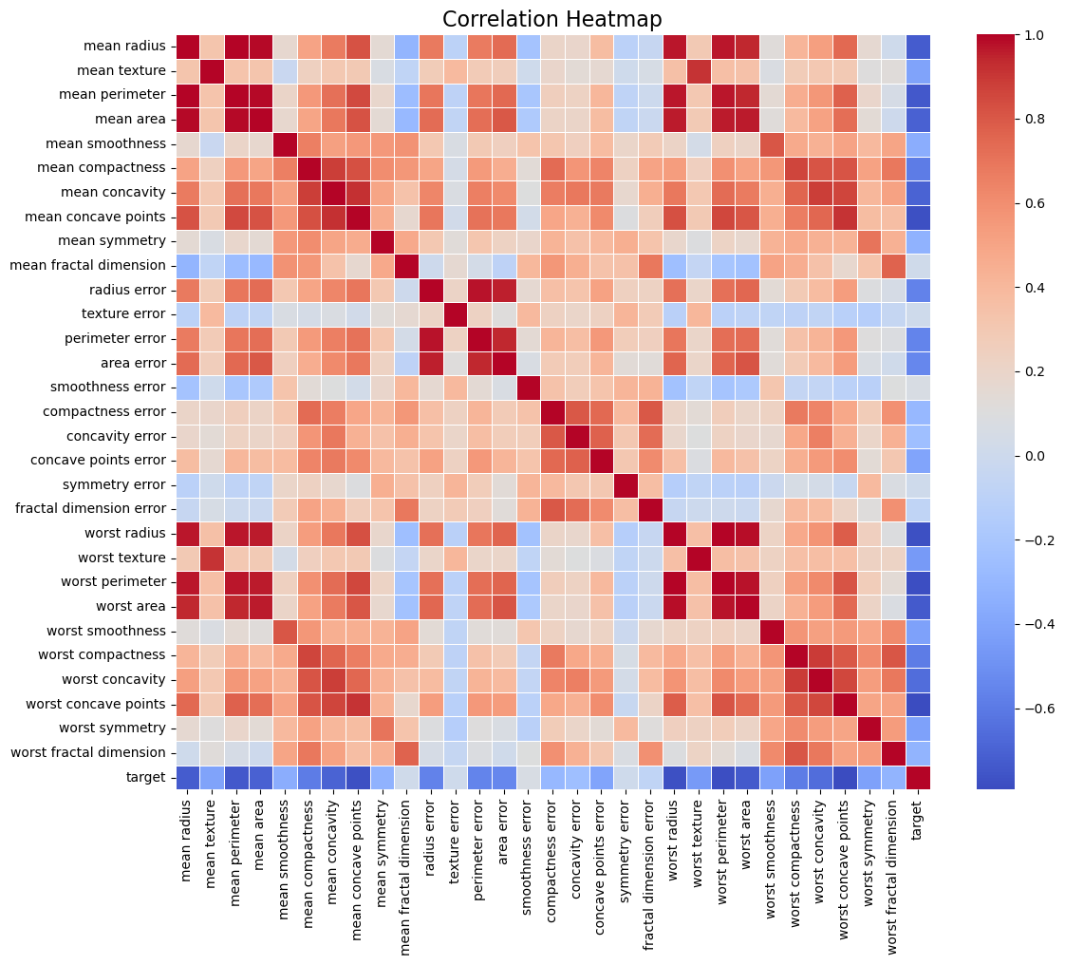
Correlation Heatmap

Slide 13
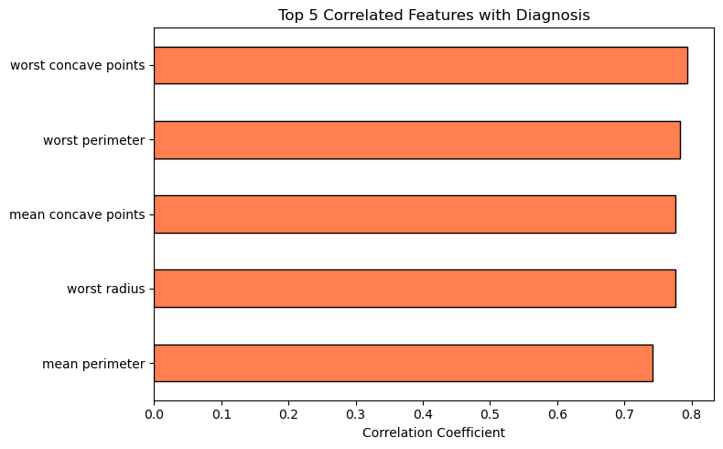
Top Features Correlated with Diagnosis

Slide 14
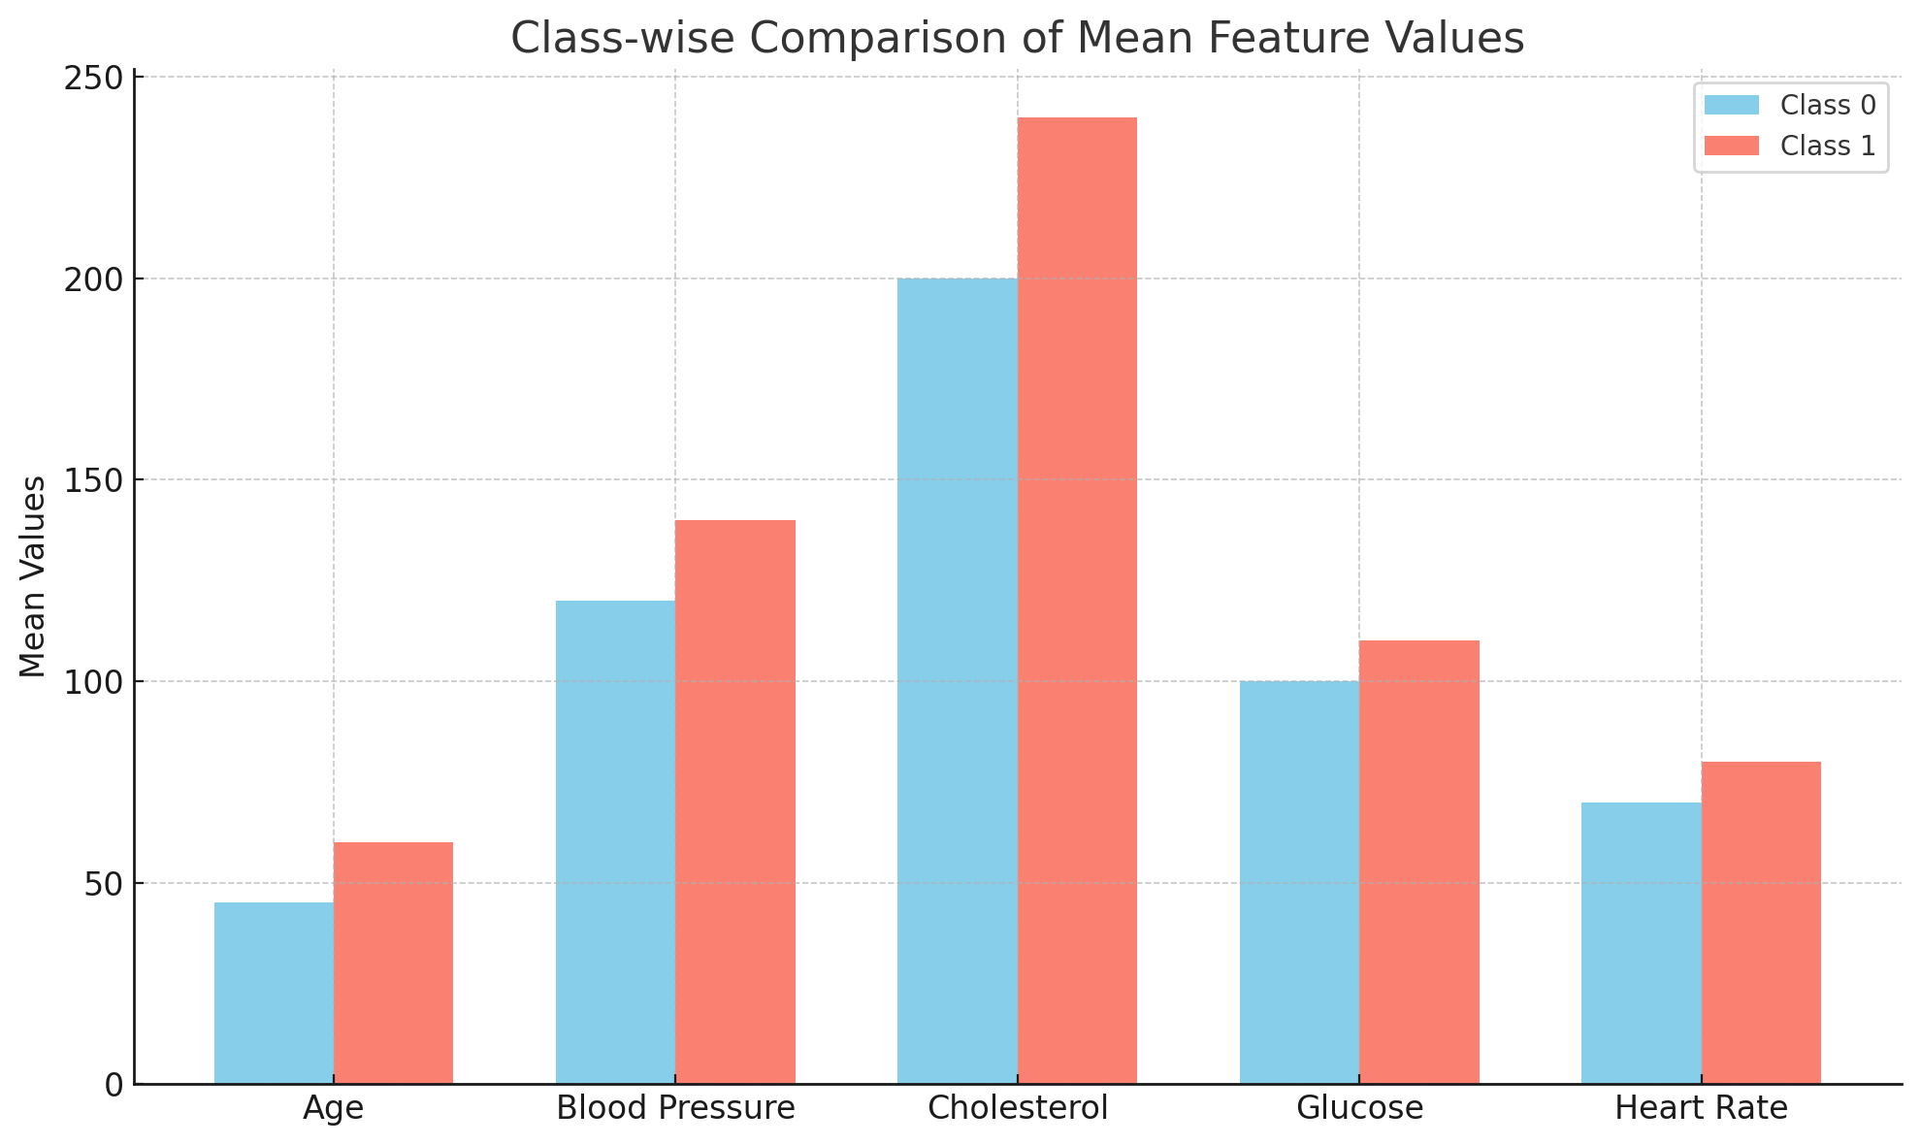
Class-wise Mean Feature Comparison

Slide 15
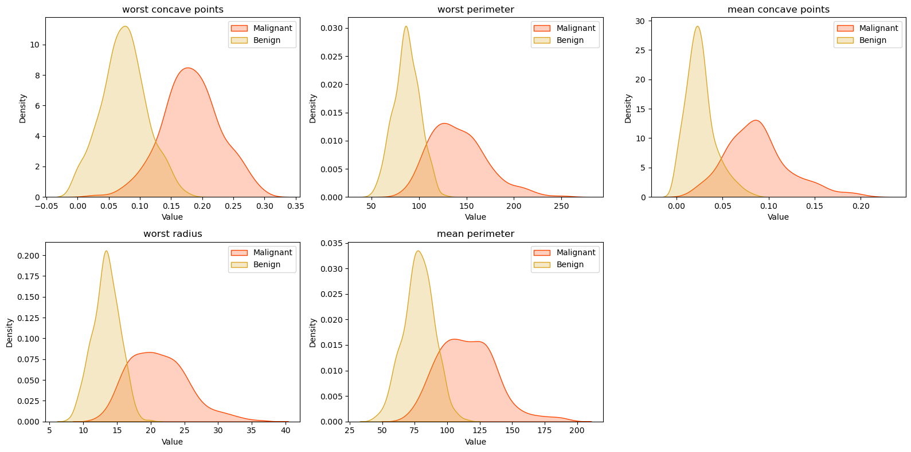
Density Plots of Predictive Features

Slide 16
📌 Conclusion & Key Insights
More benign cases than malignant — consider balancing during modeling
Malignant tumors show higher radius_mean, perimeter_mean, and area_mean
Visual patterns suggest features are useful in classification
Clean dataset with no missing values makes modeling reliable

Slide 17
🔧Tools & Technology
🧪 Python
Primary language used for data analysis and visualization.
📊 Libraries
NumPy: Used for numerical operations and efficient array handling.
Pandas: For data manipulation, cleaning, and transformation.
Seaborn: Statistical data visualization (correlation heatmaps, KDE plots, boxplots).
Matplotlib: General-purpose plotting library for custom and detailed graphs.
Scikit-learn: (used in part 2/modeling) for dataset loading, preprocessing, and evaluation.
📁 Jupyter Notebook
Interactive environment for step-by-step data analysis and exploration.
🖼️ Microsoft PowerPoint
For presenting the findings in a visual and concise format.
📄 PDF (via FPDF)
Summary report generation with plots and textual insights embedded.
📦 Pillow (PIL)
Image optimization for embedding visualizations into reports.

Slide 18
📊 What We Learned from This Analysis
• Dataset is clean and well-prepared for predictive modeling.
• Features like concave points and perimeter are highly predictive.
• Visualization confirms feature separation across tumor classes.
• Foundation is strong for applying classification algorithms.

Slide 19
THANK YOU

